Slide 1

Visualizing COVID and Its Effects
Lamarcus Coleman, Yifan Pan

Slide 2

Project Goal
“ Our goal is to apply the concepts covered in IFSC 5345: Information Visualization to a real-world scenario. Our aim is to also use multiple visualization mediums as a means of telling a story with data”

Slide 3
Problem Statement
“To Understand COVID’s Inherent Trends, Patterns, and Relationships as well as Associate Developments of the Pandemic to Various Aspects of Society”

Slide 4
Research Questions

Slide 5
Research Questions
Questions were broken down into two phases based on our problem statement
Phase 1 focuses on the analysis of the pandemic
Phase 2 focuses on looking for causality between ongoing COVID developments and facets of society

Slide 6
Phase 1 Questions
What trend(s) exists in new cases, total cases, total deaths, vaccinations and testing in the US and globally?
Is testing in the US an indicator of the change in total deaths worldwide?
Does a relationship exist between testing in the US and new cases?
Are total deaths, total cases, and new cases correlated across countries?
What’s the relationship between US deaths and deaths globally?
Does a correlation exist between US total deaths and new cases worldwide?

Slide 7
Phase 1 Questions cont’d
Does a correlation exist between deaths worldwide and cases in the US?
What is the relationship between cases and deaths in the US?
What effect does new cases have on the change in testing and total deaths in the US?
How has vaccinations varied over time globally?
What effect has US and Global vaccinations had on total cases?
To what extent has US vaccinations altered the number of deaths and total cases?
How has vaccinations globally changed the number of reported cases and deaths?

Slide 8
Phase II Questions
To what extent has ongoing developments regarding the pandemic influenced activity in the US stock market
How has COVID impacted changes in employment in the US

Slide 9
Assessing Visualizations

Slide 10
Tufte’s Principles
Maximize Data-Ink Ratio
Avoid Chart-Junk
Use Multifunctioning Graphical Elements
Use Small Multiples
Show Mechanism, Process, Dynamics, and Causality

Slide 11
Datasets

Slide 12
Datasets Used
COVID
New cases
Total cases
Total deaths
Testing
Vaccinations
Stock Market
SPY ETF
Unemployment Data from US Dept. Labor

Slide 13
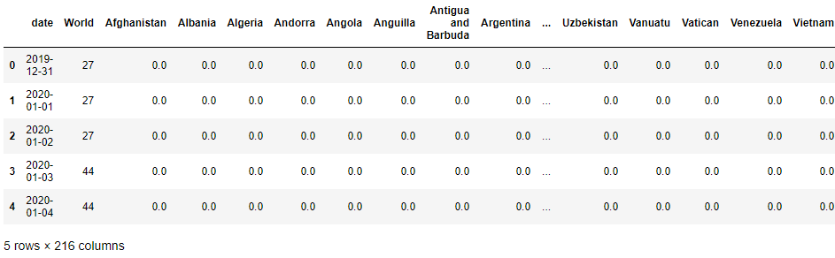
New Cases, Total Cases, Total Deaths Data Sample

Slide 14
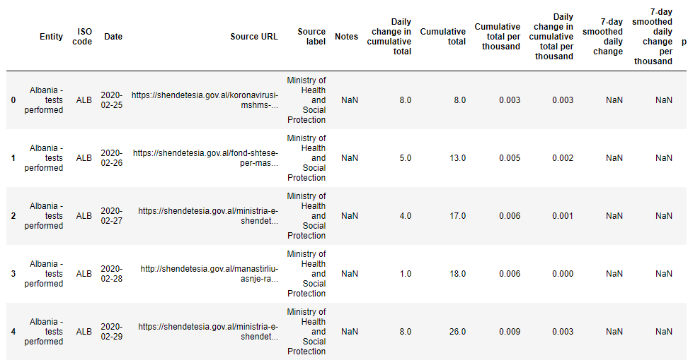
Testing Data Sample

Slide 15
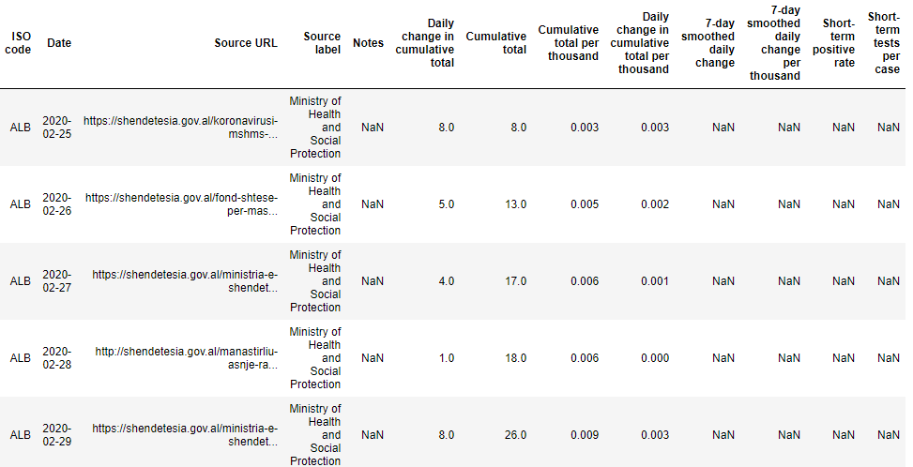
Testing Data Sample Cont’d

Slide 16
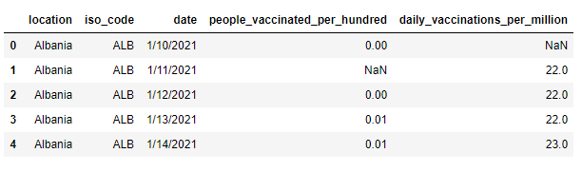
Vaccinations Data Sample

Slide 17
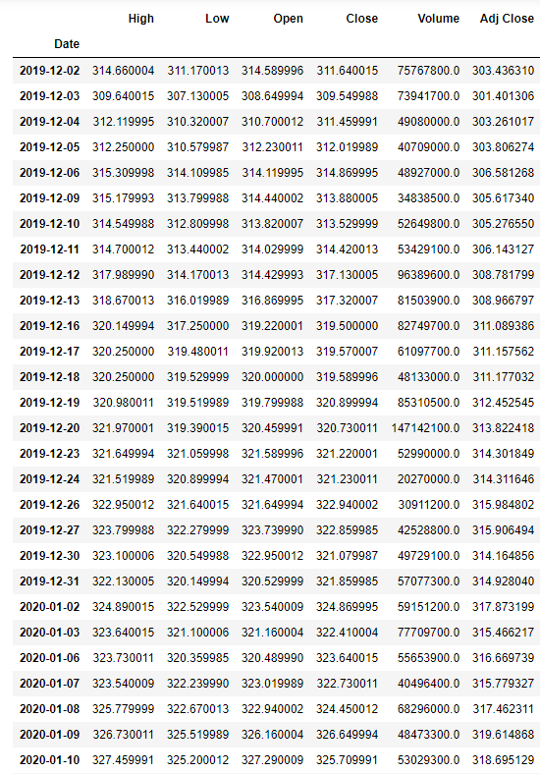
Stock Market Data Sample

Slide 18
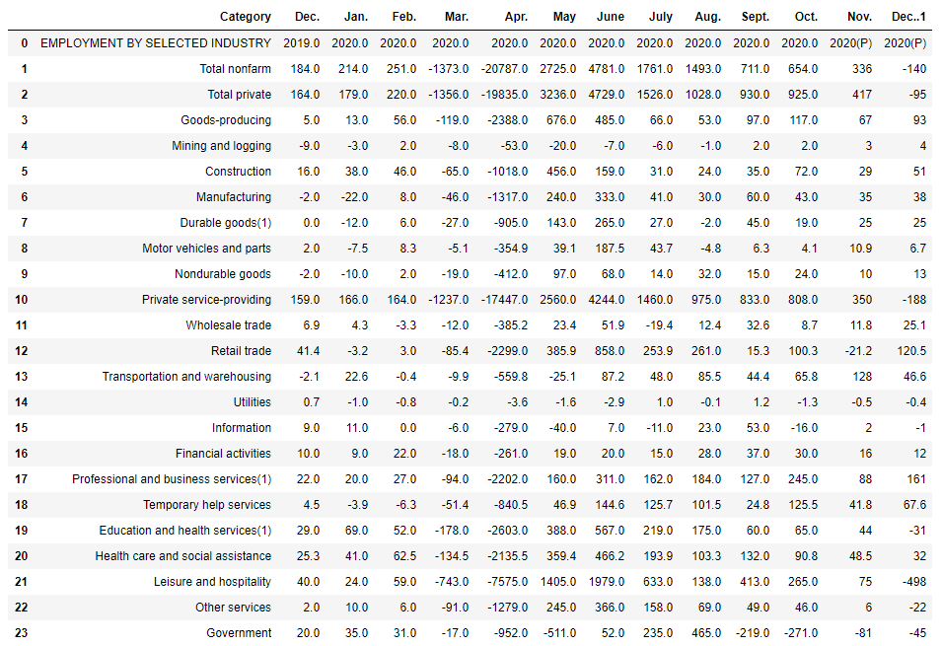
Employment Data Sample

Slide 19
Visualizations

Slide 20
Phase I

Slide 21
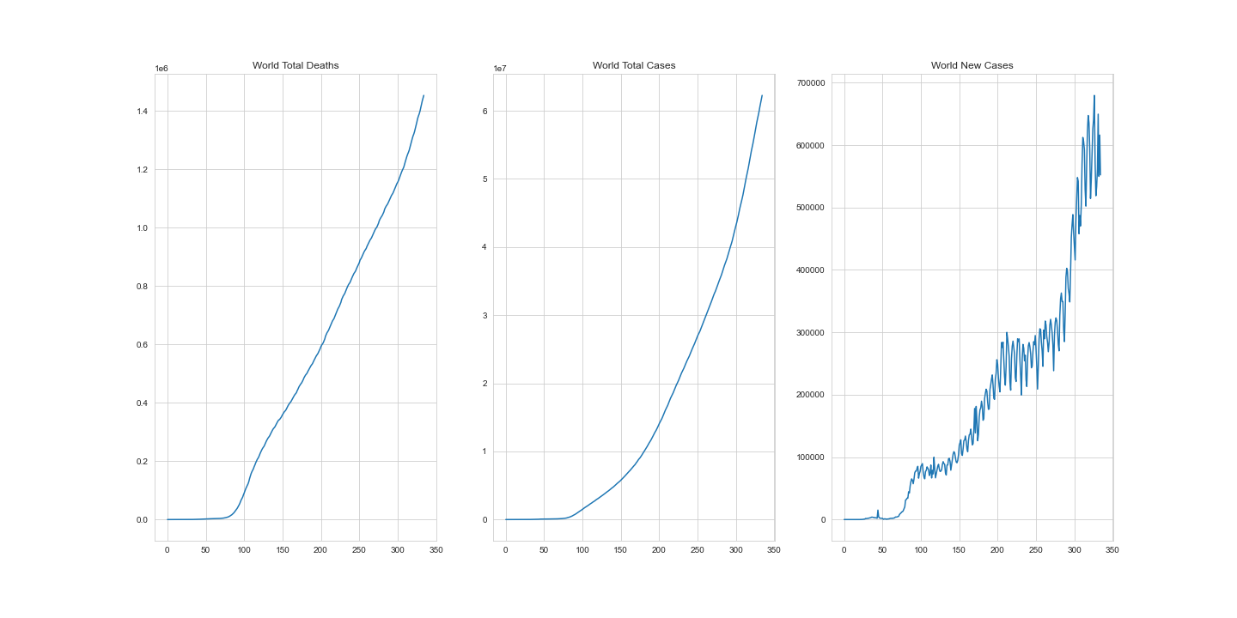

Slide 22
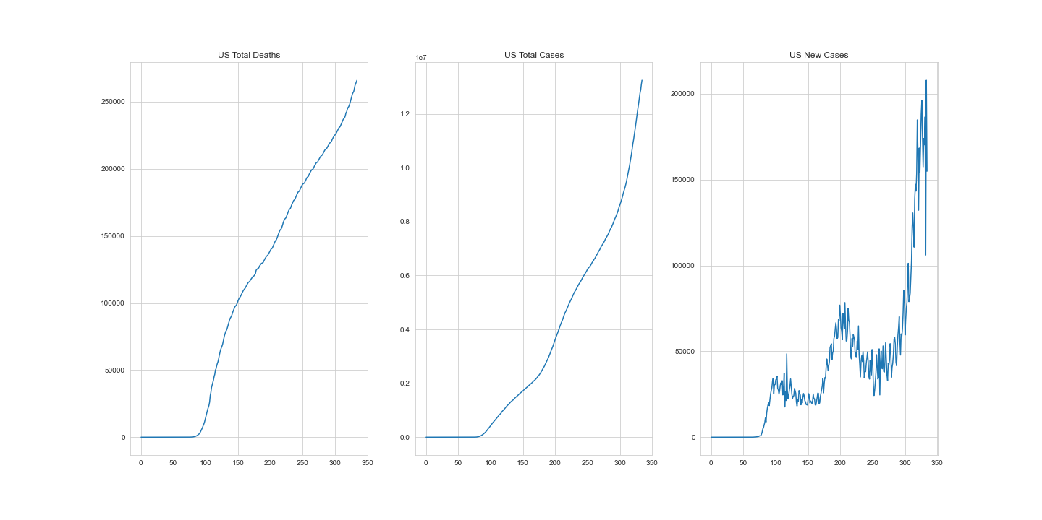

Slide 23
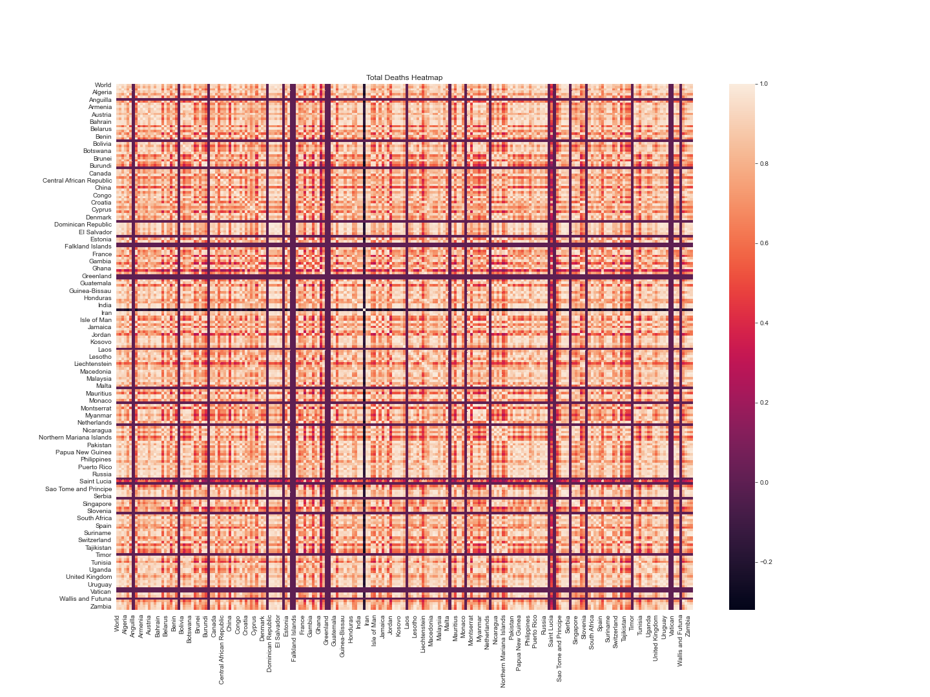

Slide 24
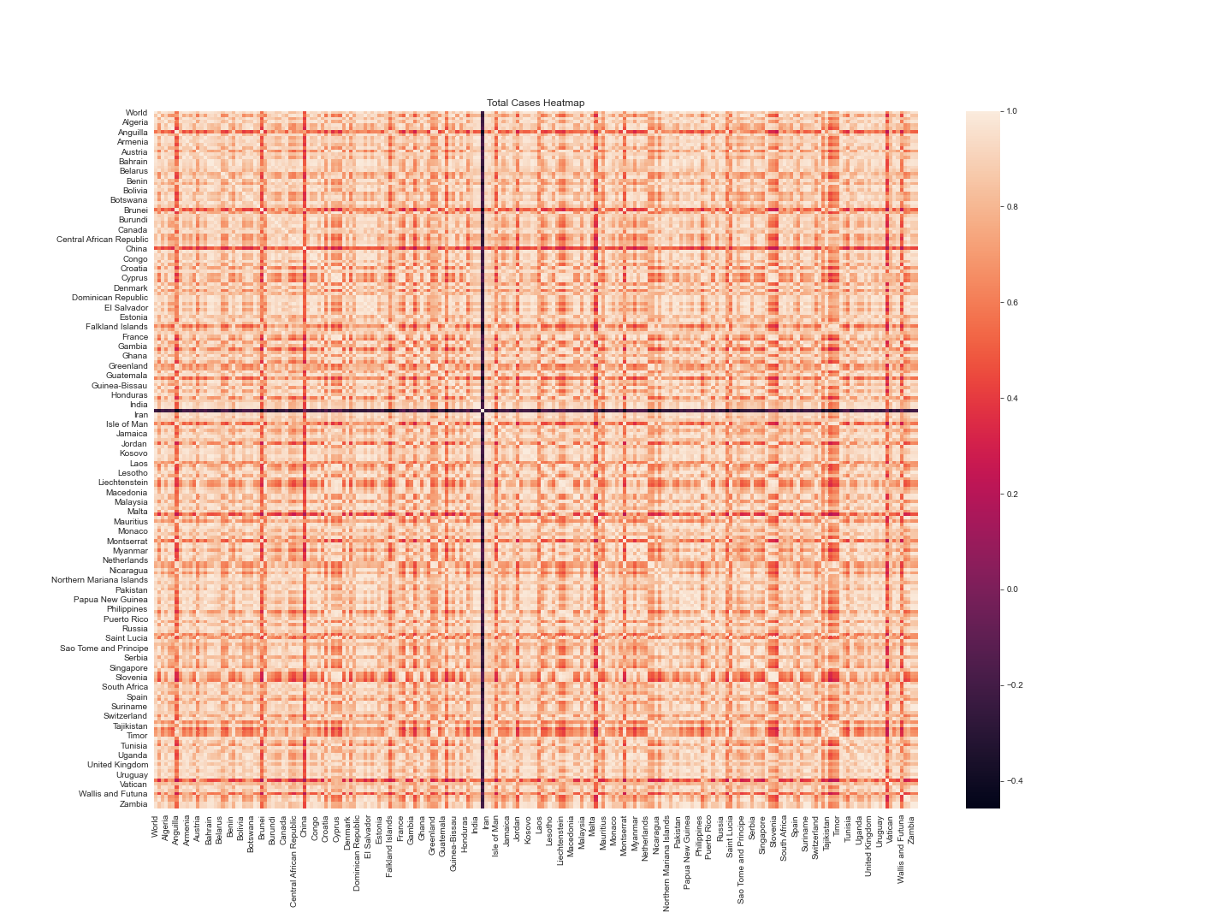

Slide 25
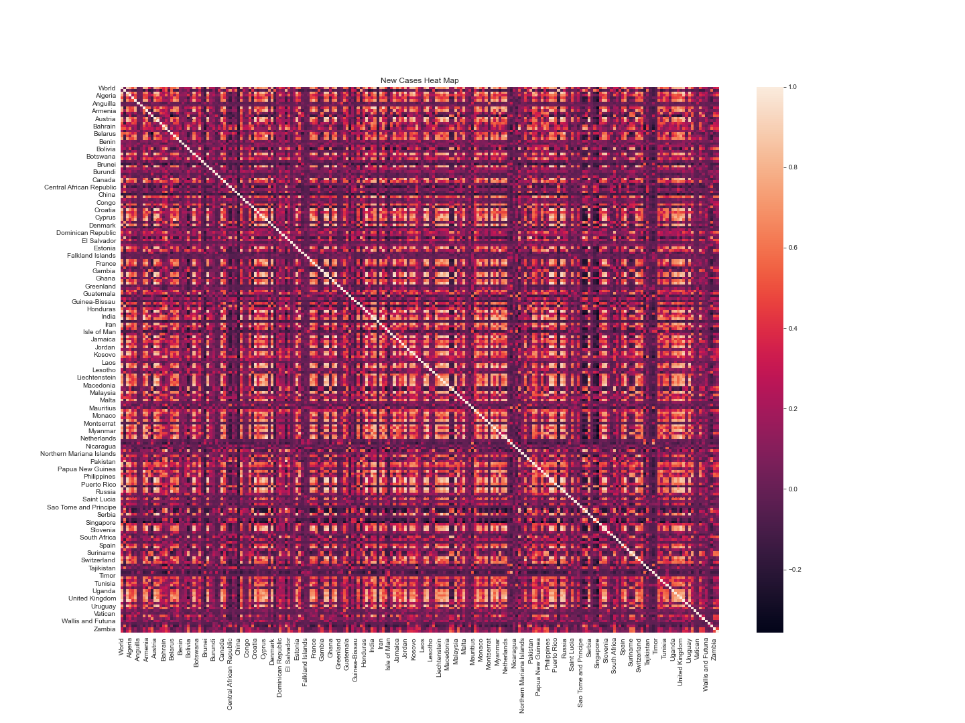

Slide 26
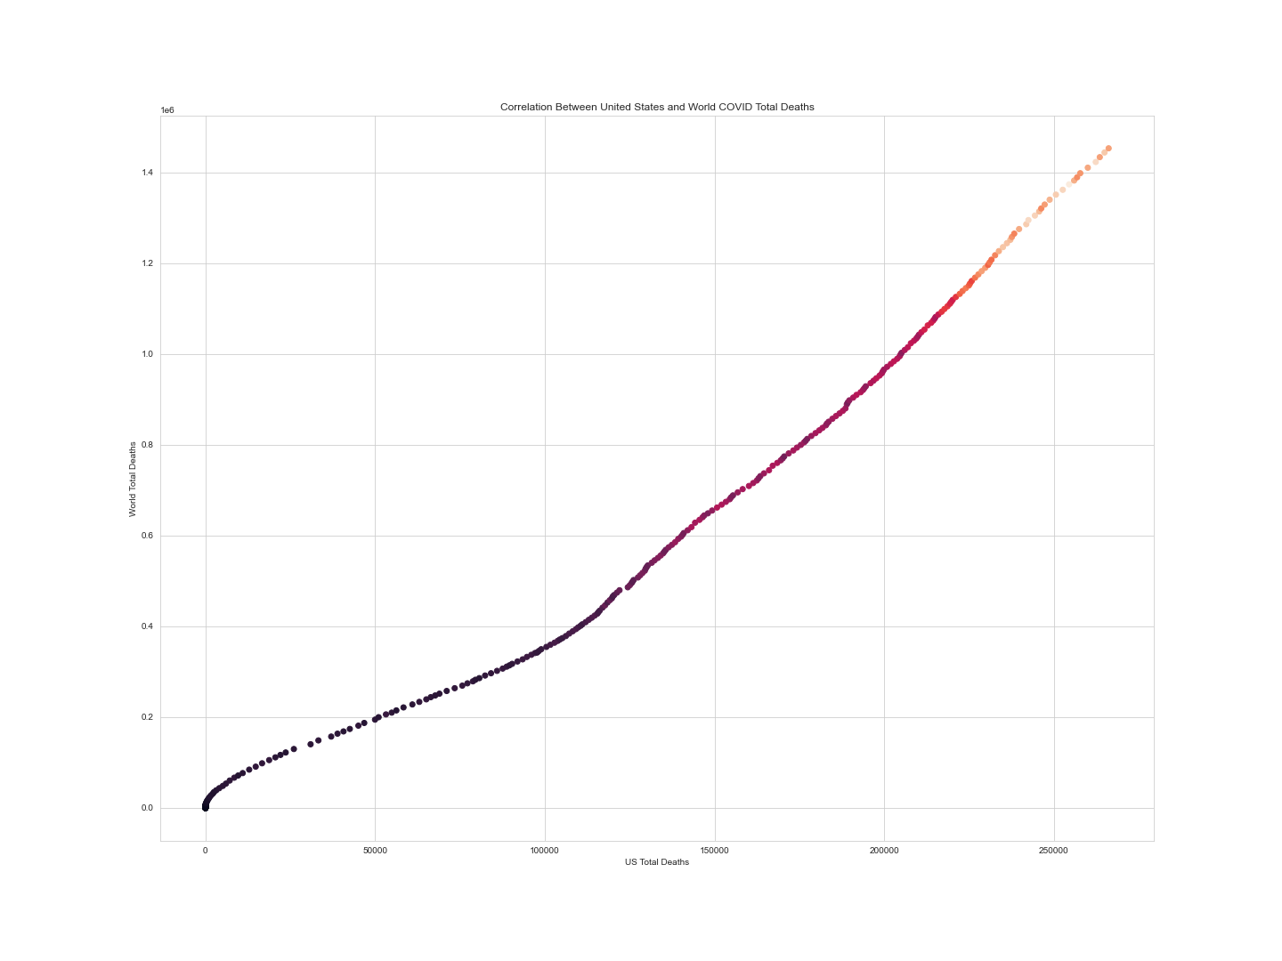

Slide 27
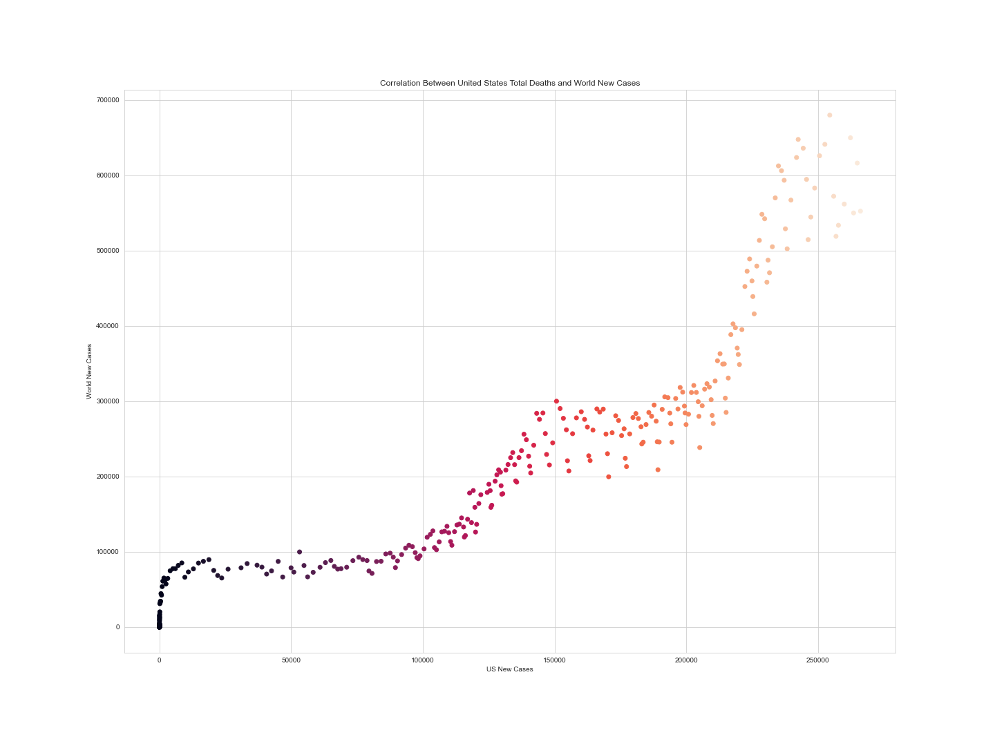

Slide 28
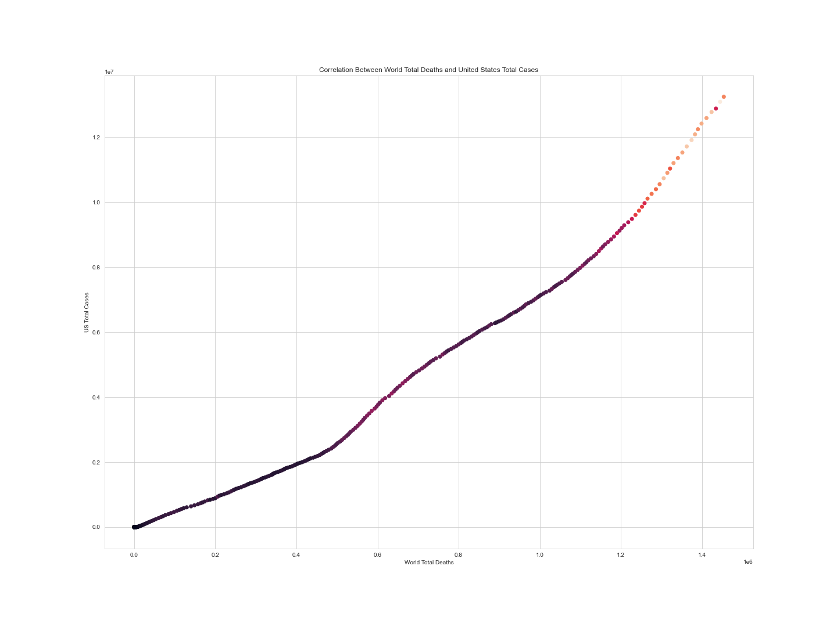

Slide 29
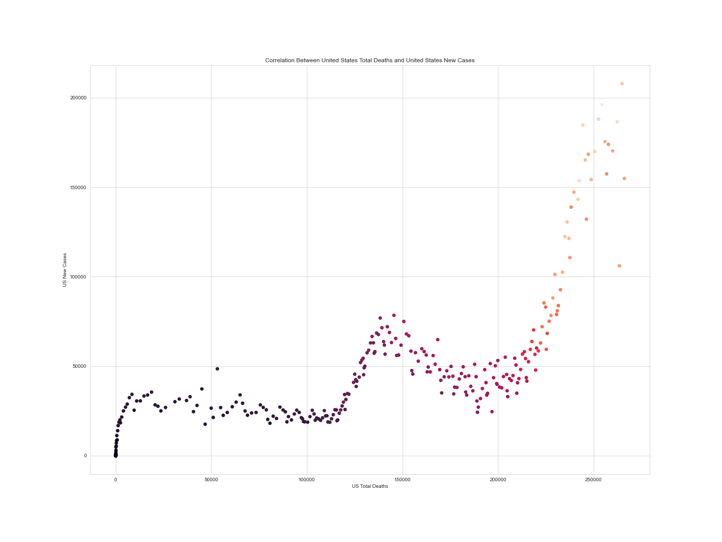

Slide 30
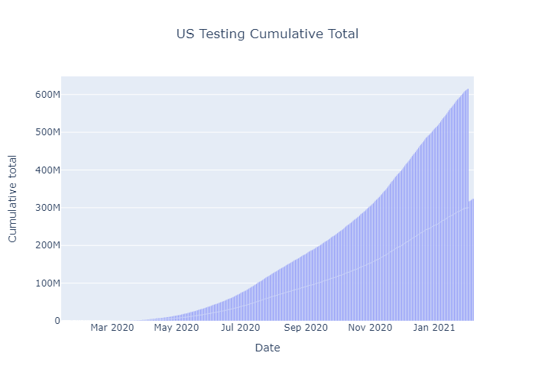

Slide 31
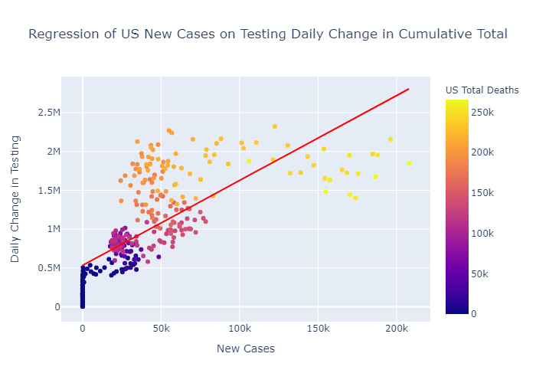

Slide 32
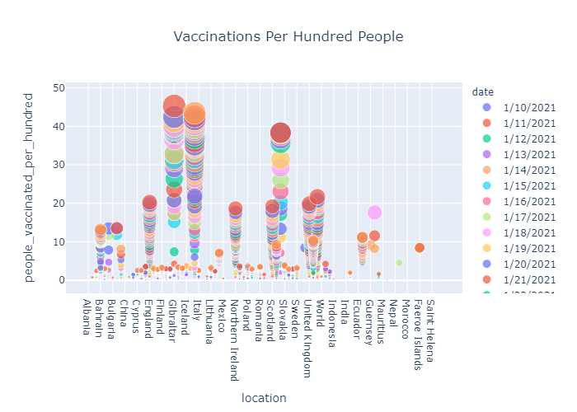

Slide 33
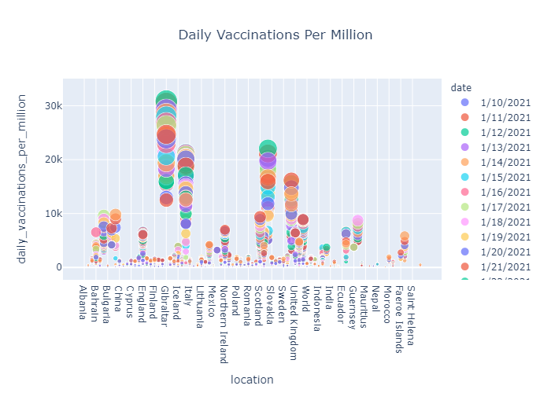

Slide 34
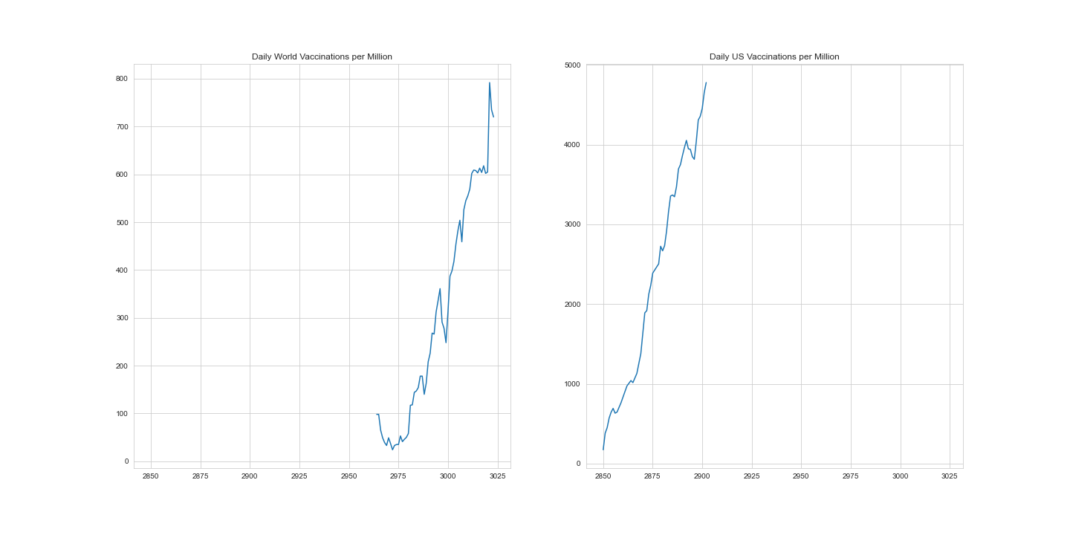

Slide 35
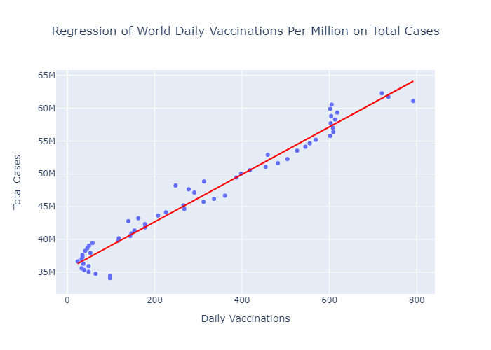

Slide 36
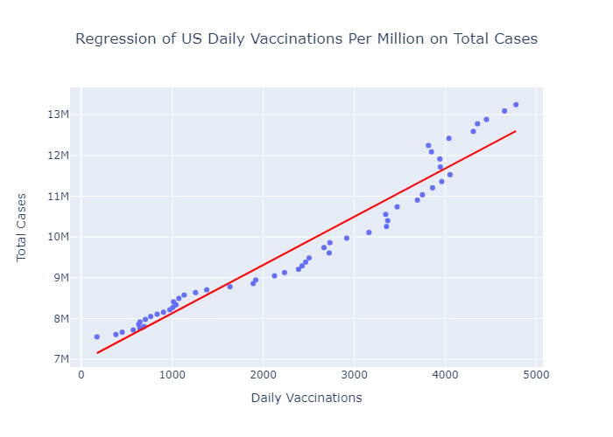

Slide 37
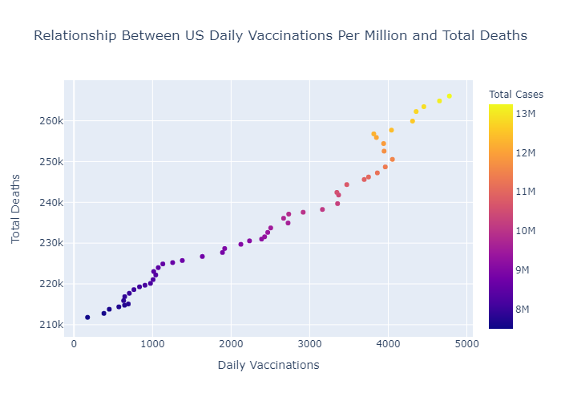

Slide 38
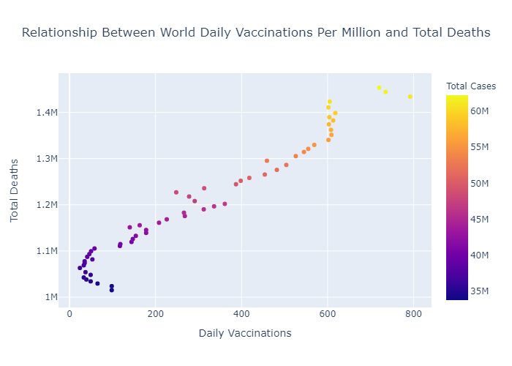

Slide 39
Phase II

Slide 40
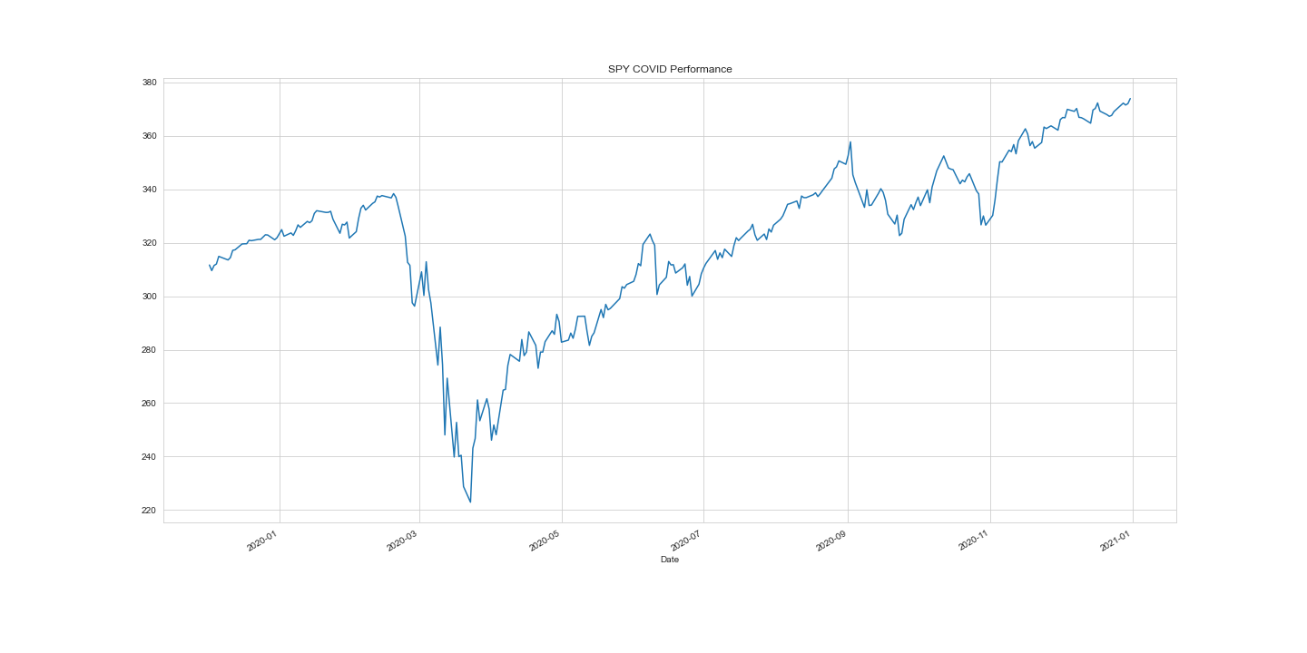

Slide 41
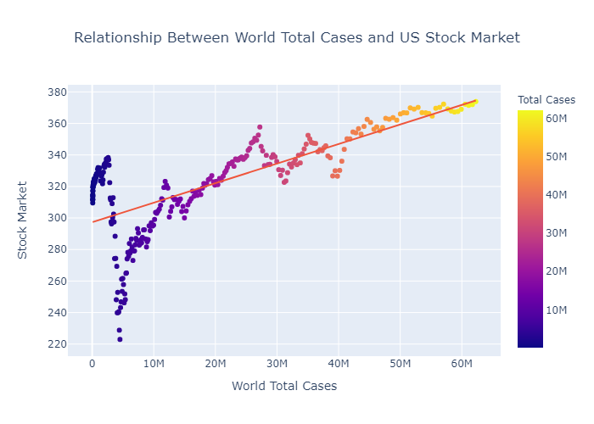

Slide 42
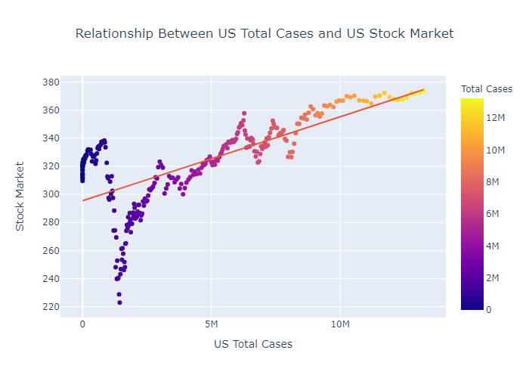

Slide 43
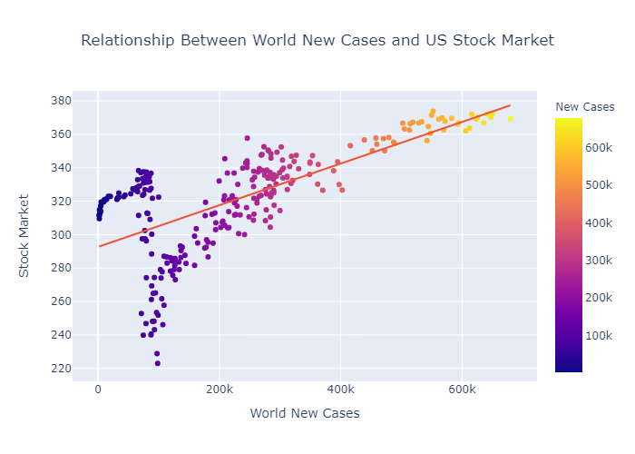

Slide 44
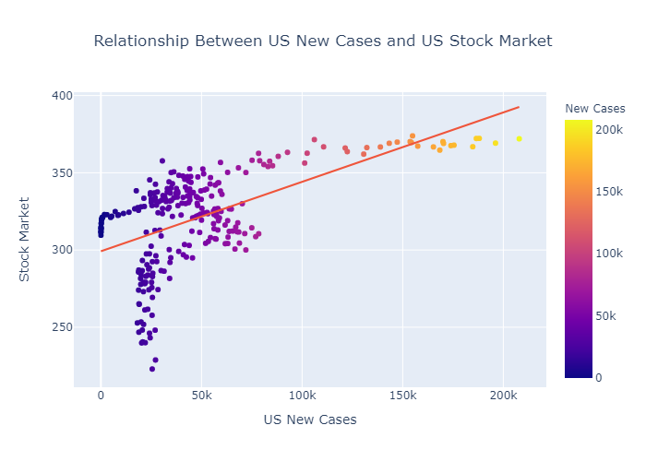

Slide 45
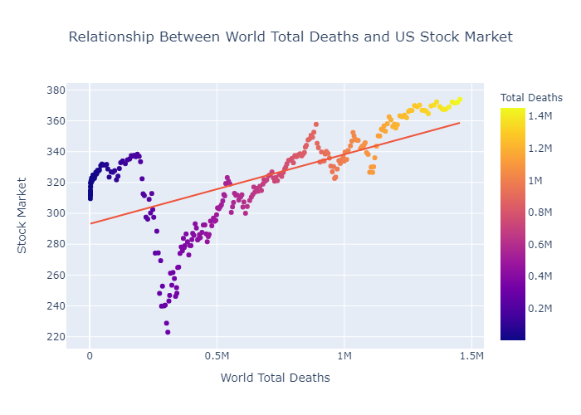

Slide 46
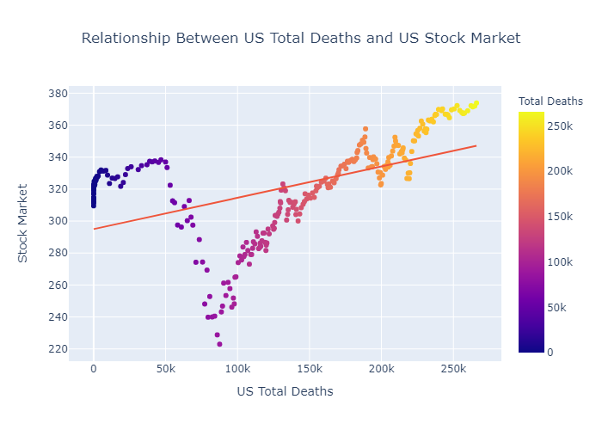

Slide 47
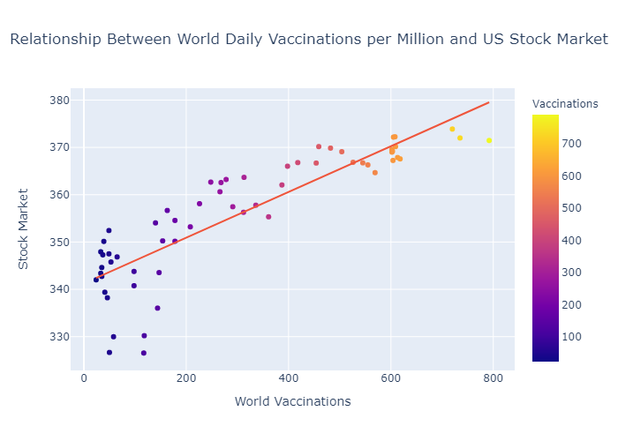

Slide 48
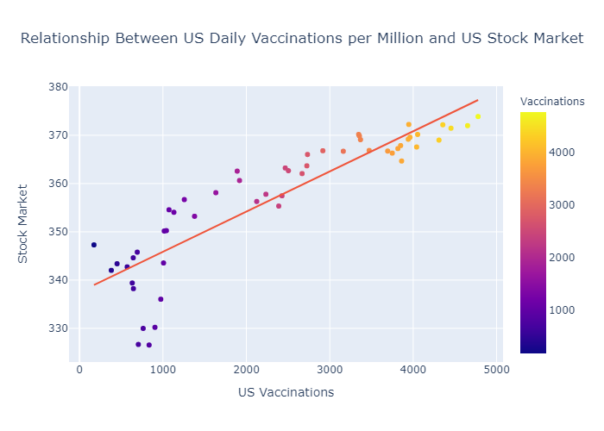

Slide 49
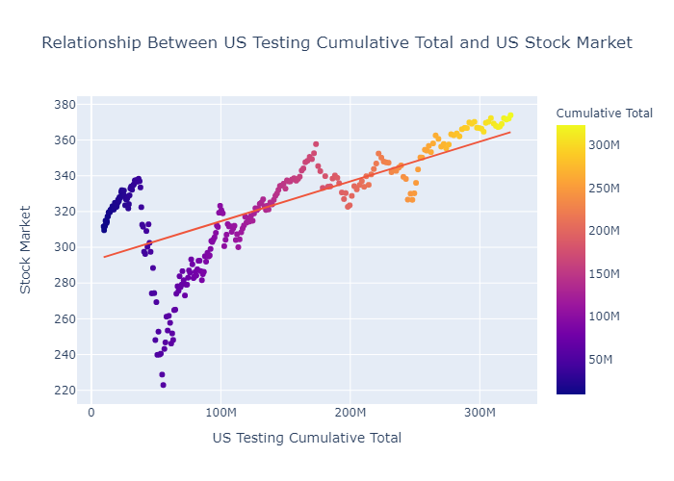

Slide 50
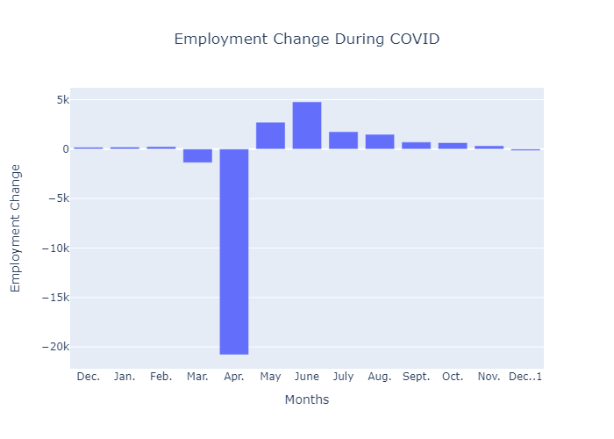

Slide 51
Visualization Technologies Used
Tableau
Matplotlib
Seaborn
Plotly

Slide 52
Thank You!

Slide 53
Contributions
Lamarcus
Python Based Visualizations
Visualizations Libraries Used: Matplotlib, Seaborn, Plotly
Yifan
Tableau Based Visualizations

